Slide 1


APRIL 2024
EXPLORATION OF FACTOR ANALYSIS IN R
Collaborative Data Science Project
Applied Data Analysis (ANT 388C)
Presenters:
SAJANA ARYAL
KEERTHI STANLEY
YAO CHEN
Moody College of Communication
The University of Texas at Austin

Slide 2
Introduction
Factor analysis is a statistical method used to identify underlying factors or dimensions that explain patterns in observed variables (Kline, 2014)
It is commonly employed to reduce the dimensionality of data.
Based on the assumption that a smaller number of unobservable factors influences observed variables.

Slide 3
Assumptions of Factor Analysis:
Data Characteristics: Assumes the absence of outliers, a sufficient sample size (where the number of cases exceeds the number of variables), and interval-level data measurement.
Statistical Assumptions: There should be linearity, absence of multicollinearity, inclusion of relevant variables, and a true correlation between variables and factors.
-Non-linear variables can be transformed to meet this requirement.
(Flora, LaBrish, & Chalmers, 2012)

Slide 4
Types of factor analysis
Confirmatory
Exploratory

Slide 5
Differences between CFA & EFA (Thompson, 2004)
Confirmatory factor analysis (CFA) | Exploratory factor analysis (EFA)
-Tests a specific hypothesis among variables based on a priori considerations. | -Explores the underlying structure of variables without prior consideration about the relationships.
-Specifies a model with predefined factors and assigns each observed variable to one or more factors. | -Does not specify the number of factors or the pattern of factor loadings beforehand.
-Requires a sufficiently large sample size to ensure stability and reliability. | -Exploratory and can be applied to small and large datasets.
-Evaluates the model’s goodness-of-fit in CFA using fit indices such as chi-square. | - Helps researchers generate hypotheses about the underlying structure of the data.
Notes:
theoretical

Slide 6
Factor loadings and Cronbach's alpha value
Factor loadings in Factor Analysis (FA) represent the correlations between observed variables.
These loadings indicate the degree to which each observed variable contributes to or is associated with each underlying factor.
A factor loading of 0.5 or higher typically indicates that the factor sufficiently captures the variance of the variable.
Cronbach's alpha measures the internal consistency of the scale or set of variables. A value closer to 1 indicates higher internal consistency (Tavakol & Dennick, 2011).
Notes:
In our code, we used factor loading method and also Cronbach alpha to see consistency.

Slide 7
Our Data: Validating the Hearing Handicap Inventory for Adults – Screening Version (HHIA-S) Questionnaire in the Nepali Language
The HHIA-S questionnaire is used to assess handicaps caused by hearing impairment among adult populations.
Prior to this paper, there was no standardized Nepali translation of the HHIA-S assessment (originally in English)
The data was collected to validate the translated Nepali questionnaire among both hearing-impaired (HI) and normal-hearing (NH) Nepalese population.
We have two datasets for our project (NH & HI).
Sample size: NH = 70, HI = 50

Slide 8
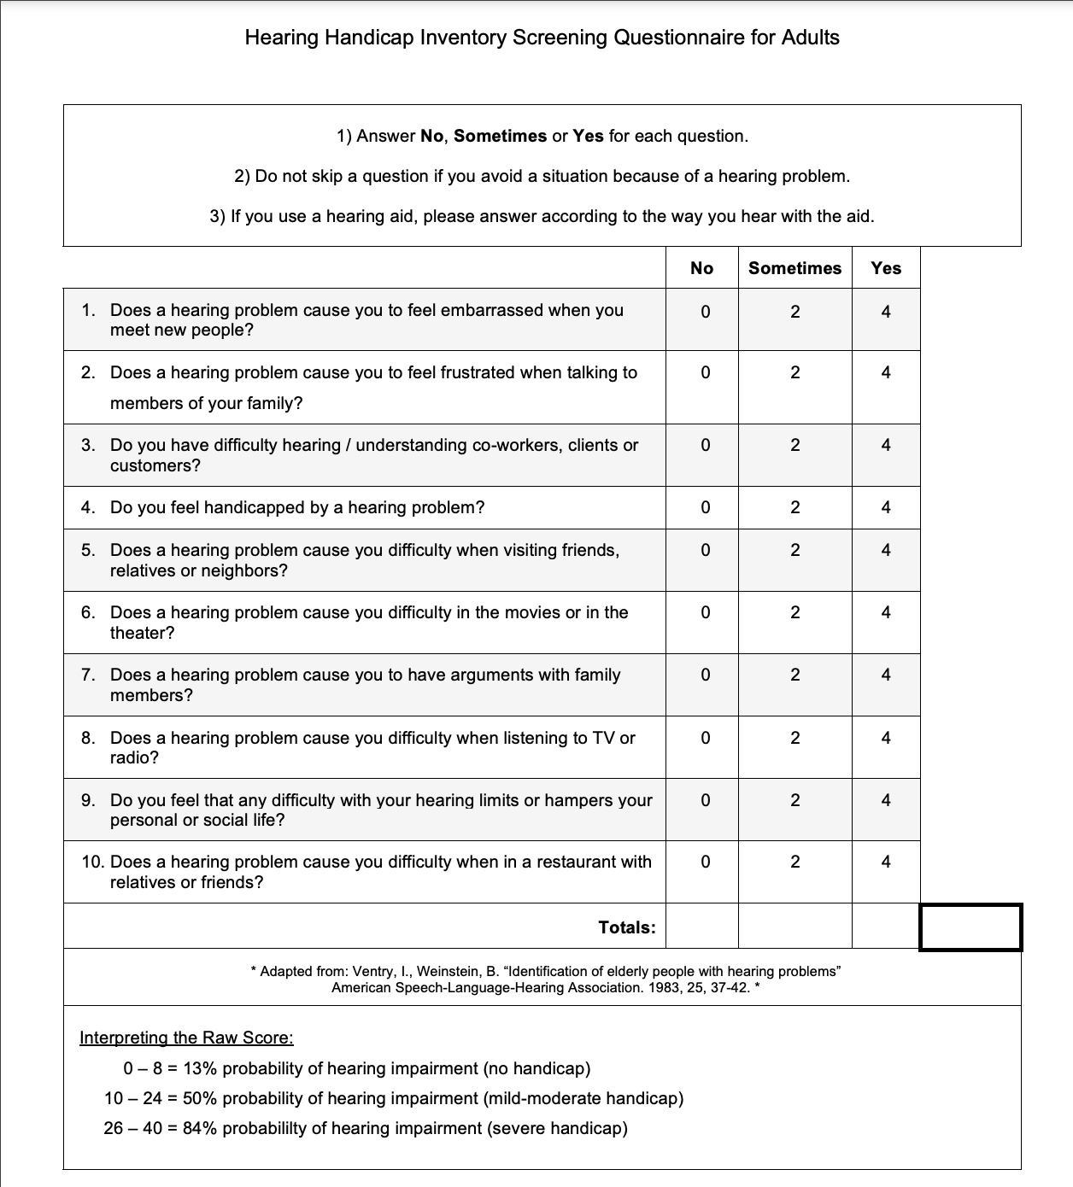
The HHIA-S Questionnaire
As shown on the right, for each question on the questionnaire, a numeric score is given based on the responses:
Yes: 4
Sometimes: 2
No: 0
These numeric scores are totaled, to interpret the level/probability of having a hearing handicap

Slide 9
Why Use Factor Analysis On Our Dataset?
The paper sought to assess the validity of the dataset when translated from English to the Nepali language
Each of the 10 questions from the questionnaire is a variable upon which factor analysis can be conducted
Exploratory Factor Analysis (EFA): allows us to assess the internal consistency and reliability of each question’s translation across participants, based on the numeric scoring of their responses
Confirmatory Factor Analysis (CFA): allows us to create a tentative model for the most effective variables (questions) in the questionnaire, and determine how fitted this model factor explains the efficacy of the translation

Slide 10
Objectives set for Group Project
Write a code for running factor analysis (both exploratory and confirmatory code) using the available original packages (e.g. Psych and Lavaan).
Create a custom package called “FACTOR” that includes the functions of confirmatory factor analysis and exploratory factor analysis.
Run a custom package with our dataset and make a comparison with the findings from the original package.
Share the Github repo that includes the created package along with the vignette and .tar.gz file so that the custom package and vignette file are accessible.
Notes:
KEETHI WILL explain code for both exploratory and confirmatory factor analysis
Yao will talk about custom package development
And at last we will share github url and .gz.tar file for the accessibility of the workflow

Slide 11
Confirmatory factor analysis code for dataset

Slide 12
Confirmatory factor analysis output
Notes:
Estimator: ML (Maximum Likelihood). This indicates the estimation method used to fit the model. Maximum Likelihood estimation is a commonly used method in CFA for estimating model parameters.
Optimization Method: NLMINB. This refers to the optimization algorithm used during model fitting. NLMINB stands for Nonlinear Minimization with Box Constraints, which is a numerical optimization method.

Slide 14
Exploratory factor analysis code

Slide 15
Exploratory factor analysis output
Notes:
MRI ; Factor 1
"SS loadings" typically stands for "Sum of Squared Loadings." It represents the total variance accounted for by the factor. In other words, it shows how much of the total variance in the observed variables is explained by the factor.
Cronbach's Alpha: Cronbach's alpha measures the internal consistency of the scale or set of variables. A value closer to 1 indicates higher internal consistency.
Factor loadings represent the correlations between observed variables (items) and the underlying factor (MR1 in this case). Higher absolute values of factor loadings indicate stronger relationships between the variables and the factor (>0.5 = good)

Slide 16
Custom R Package development
We created a custom R package that includes exploratory and confirmatory factor analysis functions. These functions will streamline users' factor analysis processes.
Run:
```{r setup}
library(FACTOR)
```
Notes:
install.packages(“./ FACTOR_0.1.0.tar.gz”, repos = NULL, type = “source”)

Slide 17
Function created for a new custom package

Slide 18
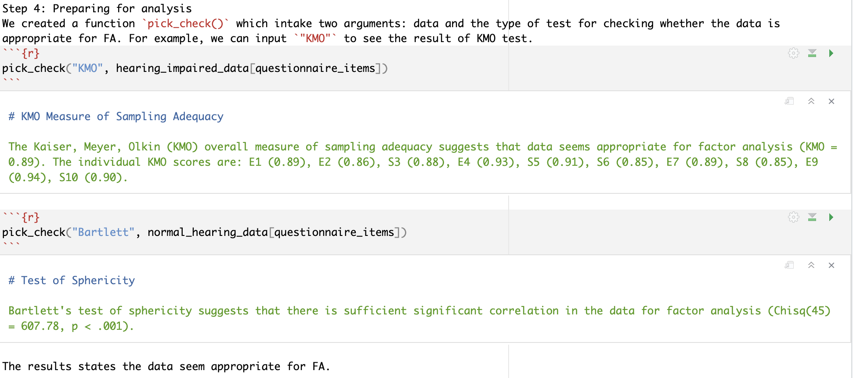
Run initial check

Slide 19
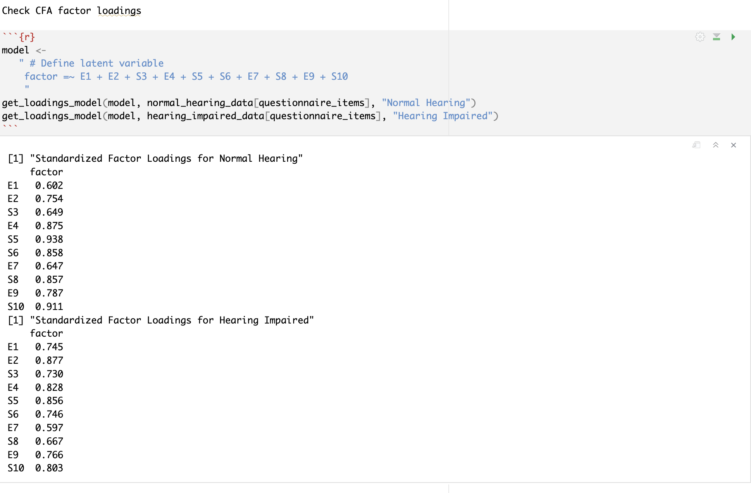
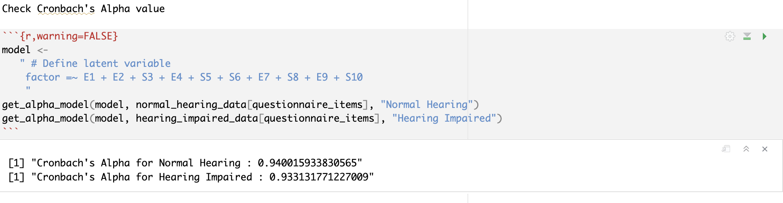
Run confirmatory factor analysis with new R package

Slide 20
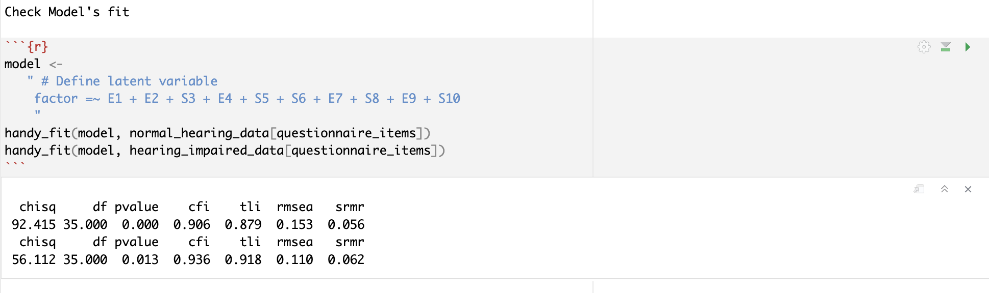
Run confirmatory factor analysis with new R package

Slide 21
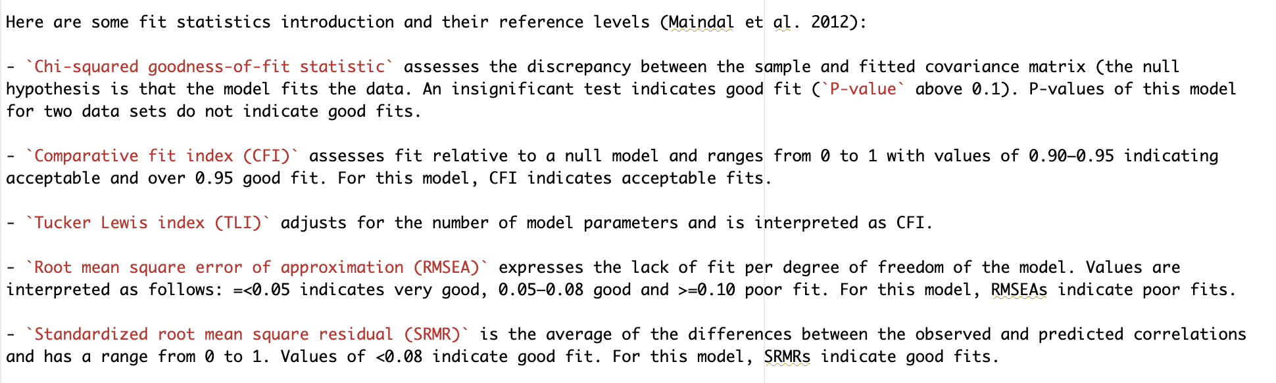
Run confirmatory factor analysis with new R package

Slide 22
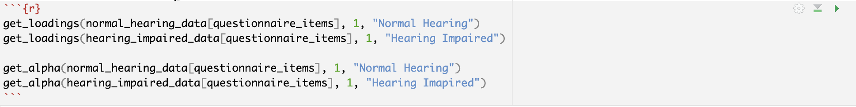
Run exploratory factor analysis with new R package

Slide 23
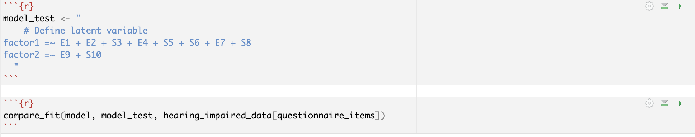
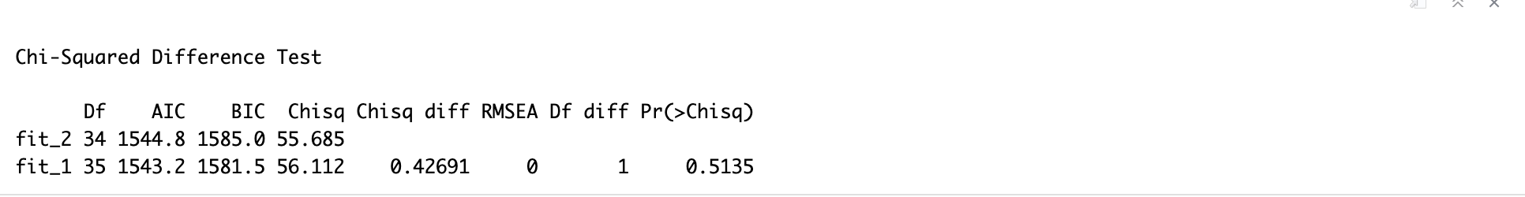
Run exploratory factor analysis with new R package

Slide 24
Github Repo Url
Github Url https://github.com/SajanaAryal1996/Collaborative-Data--Science--Project.git
Includes .tar.gz file and FACTOR Package.
Vignette’s files inside factor package includes workflow for creating and running custom R packages and comparison with the original package.

Slide 25
References
Kline, P. (2014). An easy guide to factor analysis. Routledge.
Flora, D. B., LaBrish, C., & Chalmers, R. P. (2012). Old and new ideas for data screening and assumption testing for exploratory and confirmatory factor analysis. Frontiers in Psychology, 3, 55.
Maindal, H. T., Sokolowski, I., & Vedsted, P. (2012). Adaptation, data quality and confirmatory factor analysis of the Danish version of the PACIC questionnaire. The European Journal of Public Health, 22(1), 31-36.
Tavakol, M., & Dennick, R. (2011). Making sense of Cronbach's alpha. Int J Med Educ, 2, 53-55. https://doi.org/10.5116/ijme.4dfb.8dfd
Thompson, B. (2004). Exploratory and confirmatory factor analysis: Understanding concepts and applications. Washington, DC, 10694(000), 3.

Slide 26


